Slide 1
Team Management and Managerial Decision Making
DAY-(5)

Slide 2

VIDEO

Slide 3
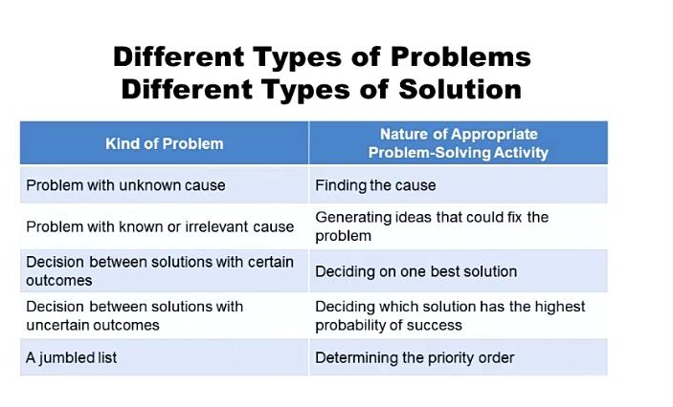
DIFFERENT TYPES OF PROBLEMS DIFFERENT TYPES OF SOLUTIONS

Slide 4
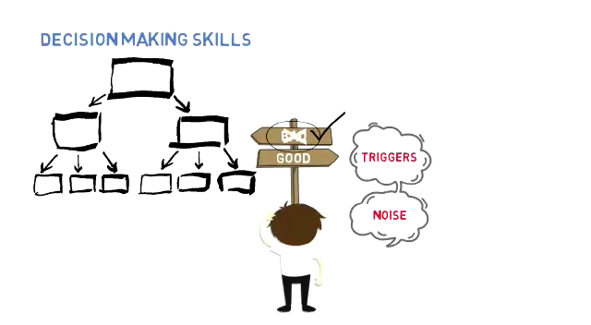
WHY POOR DECISIONS?

Slide 5
Decision Making Tools & Strategies
Marginal Analysis
SWOT Diagram
Decision Matrix
Pareto Analysis

Slide 6

Marginal Analysis

Slide 7
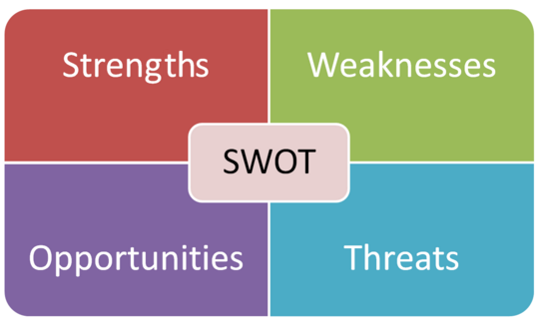
SWOT Diagram

Slide 8
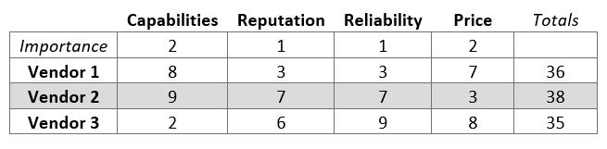
Decision Matrix

Slide 9
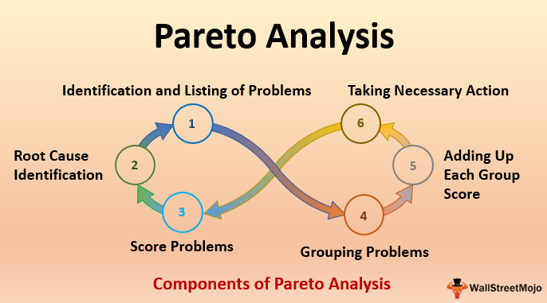
Pareto Analysis

Slide 10

TIME MANAGEMENT

Slide 11
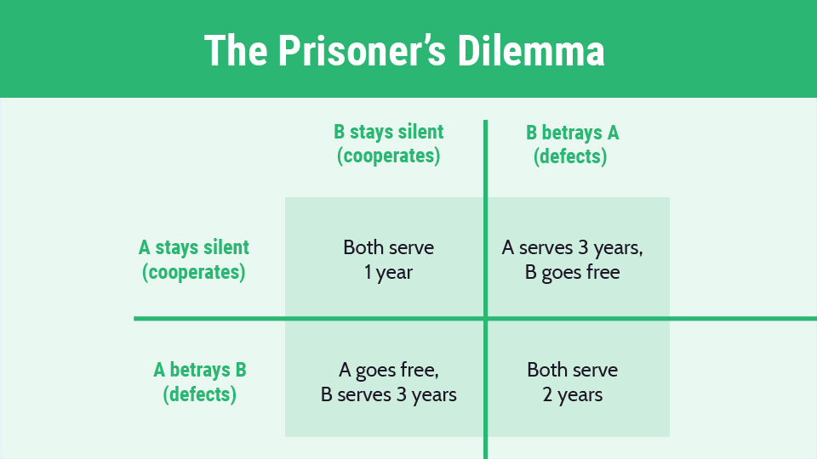
GAME THEORY

Slide 12
Three Key Elements in the Process
Know your response
Understand your biases
Consider different consequences

Slide 13
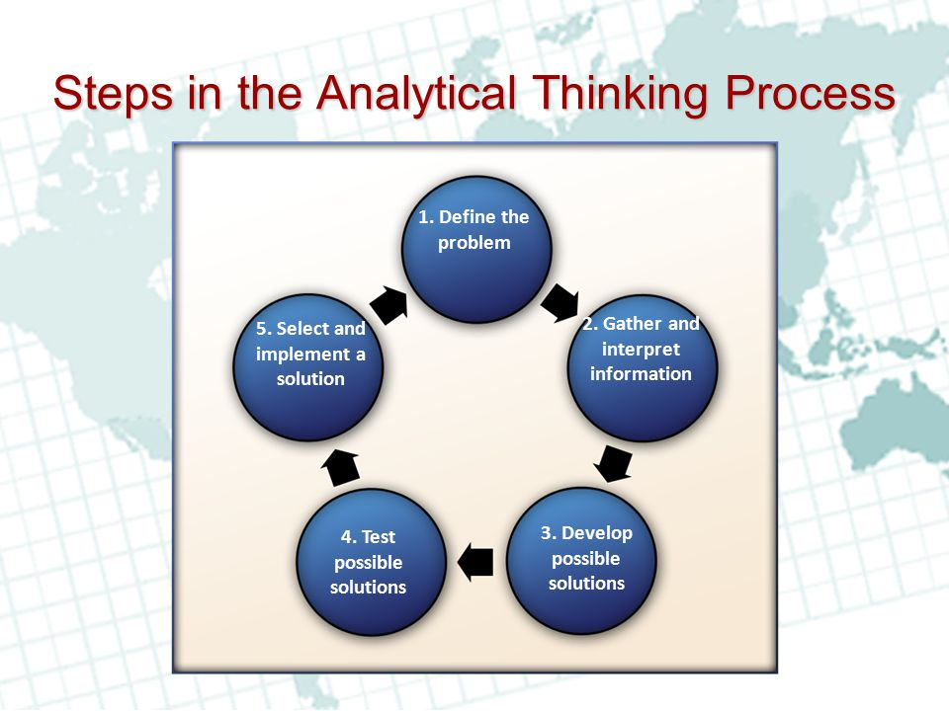
General Categories of PROBLEM SOLVING

Slide 14
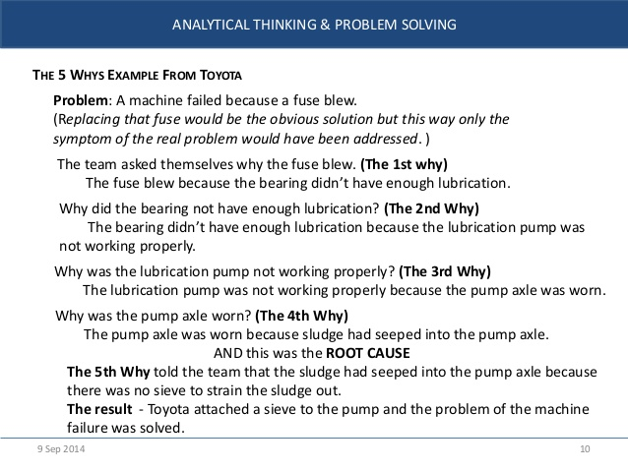
ASK YOURSELF-WHY!!??

Slide 15
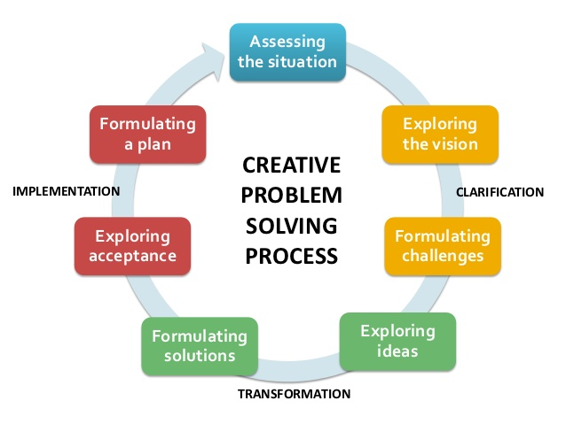
General Categories of PROBLEM SOLVING

Slide 16
DISCUSSION
Did you ever faced a dilemma in making a concrete decision and how did you came out of that?
What was the outcome?
What barriers you faced?

Slide 17
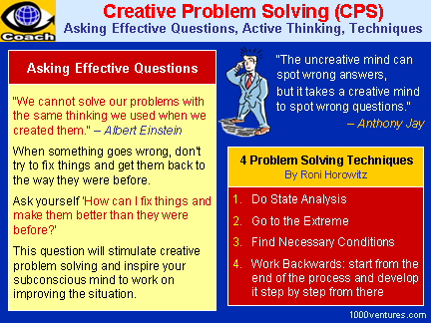

Slide 18
CASE STUDY PROBLEM STATEMENT
Martha has been assigned a team of 10 people
They just haven’t really come together as a team
She was sure she started off well and communicated their responsibilities well.
If someone needs help, no one pitches in to assist
One of the team member had an emergency, no one offered to help so Martha jumped in to assist.
Martha was disappointed

Slide 19
SOLUTION (TEAM BUILDING)
Should have communicated well
Should have communicated well about leadership
Should have brought the team together
Should have talked about cultural diversity
Should have spoken about cultural management
Develop processes and procedures for how the team will work

Slide 20


Slide 21


Slide 22

QUESTIONS?

Slide 23


